Slide 1
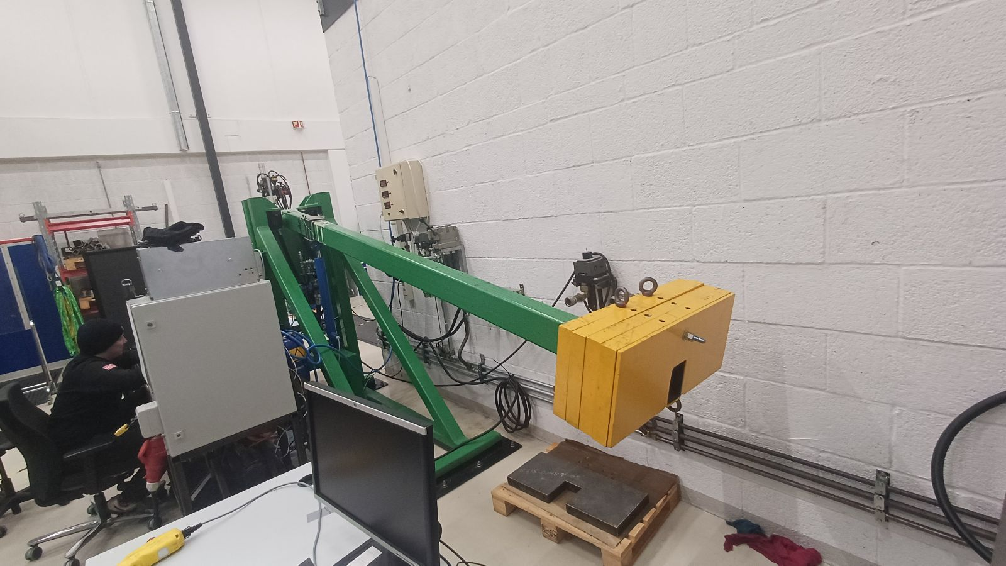
Internship Project

Slide 2
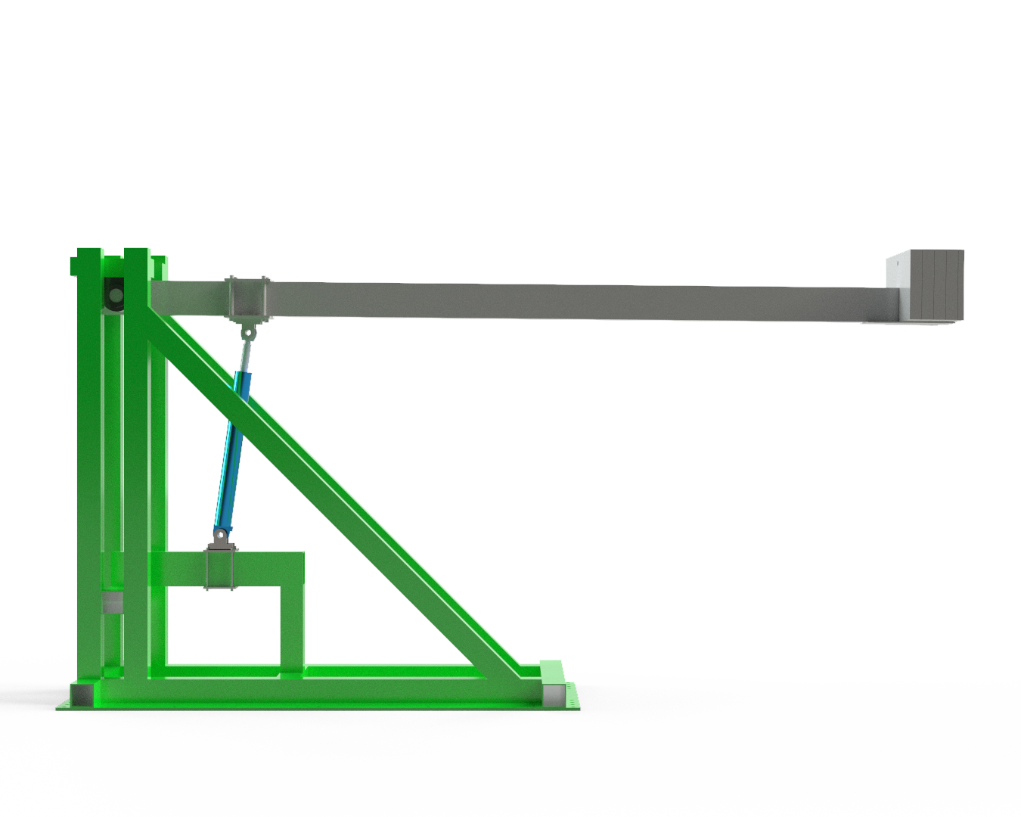

Considered system
1
U
6
P
U
P
3
Cylinder
Counterbalance valve, 3:1
Directional control valve
Pressure compensator
Variable displacement pump
Pressure transducer
Crane boom
Payload
2
7
8
U
1
P
4
5

Slide 3



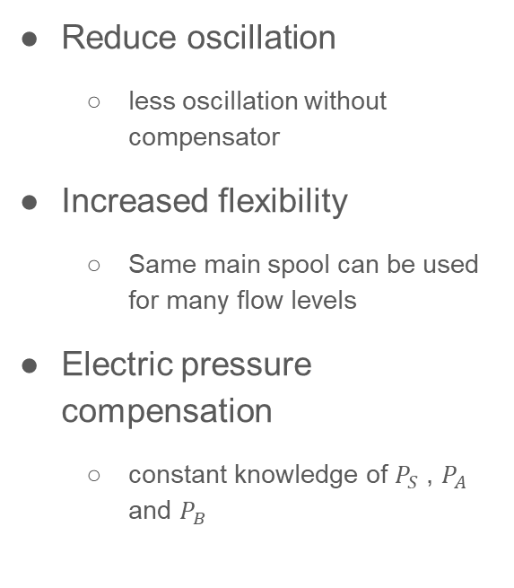
Background
1
U
$$P_{B}$$
5
P
U
$$P_{A}$$
Reduce oscillation
less oscillation without compensator
Increased flexibility
Same main spool can be used for many flow levels
Electric pressure compensation
constant knowledge of $P_{S}$ , $P_{A}$ and $P_{B}$
P
3
Cylinder
Counterbalance valve, 3:1
Directional control valve
Variable displacement pump
Pressure transducer
2
U
$$P_{S}$$
P
4

Slide 4








Control system
$$V_{ref}$$
FF
$$U_{FF}$$
$$X_{ref}$$
$$e$$
CTRL
$$U_{PID}$$
$$U$$
Valve
$$Q$$
System
$$X$$
+
+
-
+

Slide 5
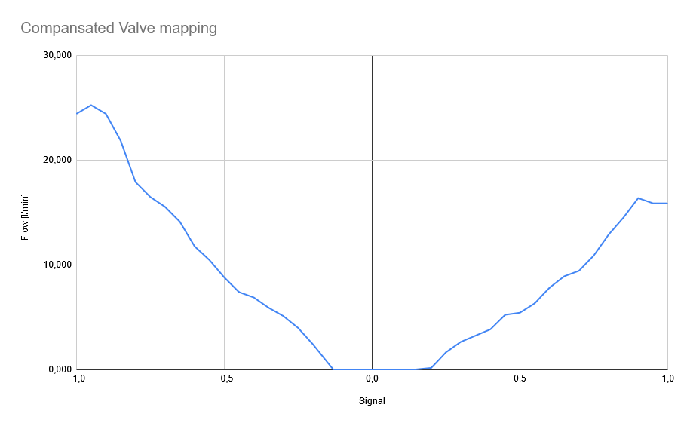
Mapping with compensator
Signal [0.2 - 1]
Calculated flow from cylinder speed
Found deadband with testing
Maxing out at u = 0.9

Slide 6
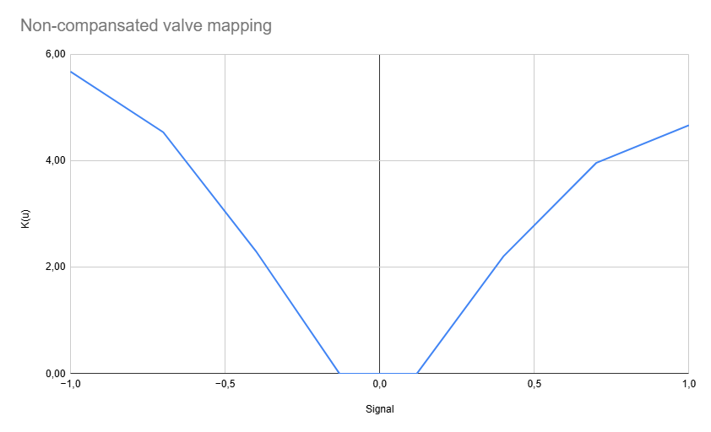

Mapping without compensator
$$K_{(u)}= \frac{Q_{ref}}{\sqrt{∆p}}$$
Valve approx. symmetric
Problems logging with high pressure drop
Found deadband with testing

Slide 7
Comparison test
Feedback + Feed Forward
Referance signal
Cosine curve position, Sine curve speed
Valves have different characteristics
The compensated is asymmetric [25-15 l/min]
The non-compensated is symmetric [25-25 l/min]

Slide 8
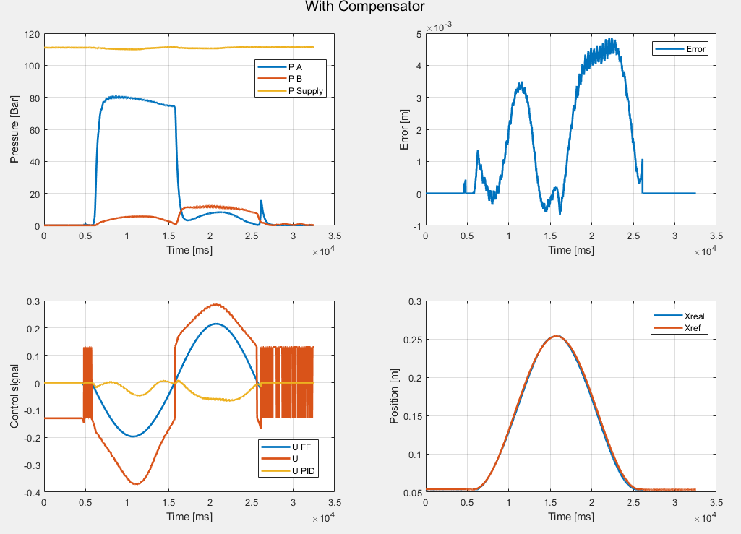

signal contribution ($U_{FF}/U_{PID}$)
Up 3.7x
Down 4x

Slide 9
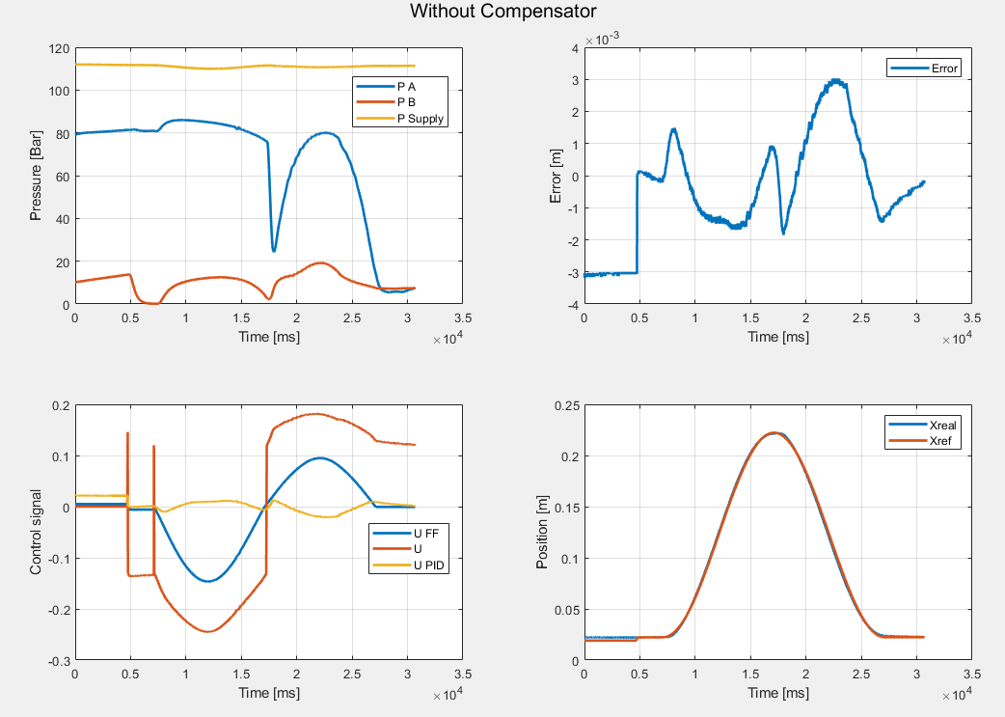
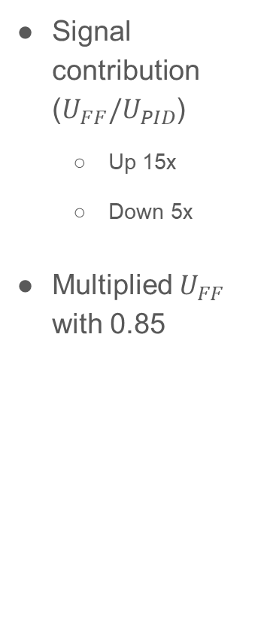
Signal contribution ($U_{FF}/U_{PID}$)
Up 15x
Down 5x
Multiplied $U_{FF}$ with 0.85

Slide 10
Further development
Fine tune the control system on green crane
Reduce oscillation
Implement on 2-degrees of freedom
Red crane
Same procedure as with green crane
LS system

